Slide 1

Fuzzy SVM For Multiclass Problems
ESANN'2002 proceedings - European Symposium on Artificial Neural Networks Bruges (Belgium),
24-26 April 2002, d-side publi., ISBN 2-930307-02-1, pp. 113-118

Slide 2

Contents
1. Introduction
2. Two-class Support Vector Machines
3. Fuzzy Support Vector Machines
4. Performance Evaluation
5. Conclusions

Slide 3
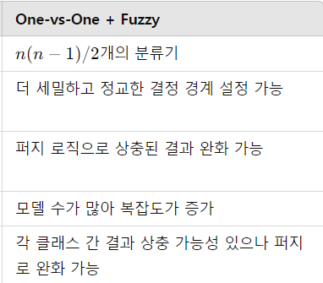
Introduction
[conventional svm]
training data is small and no overlap between classes 때 사용.
n-class problem -> n개의 two-class problems (class i와 remaining class로 나누어 비교)
=> unclassifiable resions exist.
[다음시도]
n-class problem -> n(n-1)/2개의 two-class problems (pairwise classification 2개씩 전부 다 비교)
=> unclassifiable resions exist.
[다음시도]
decision-tree-based pairwise classification
=> unclassificable regions are resolved
but 트리 형성 순서가 바뀌면 decision boundaries가 바뀐다.
=> pairwise fuzzy support vector machine을 제안

Slide 4

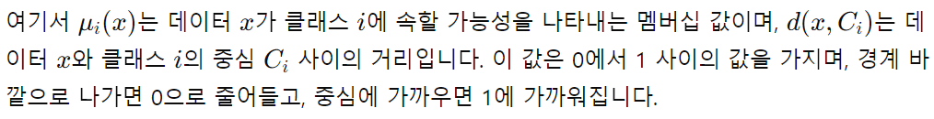

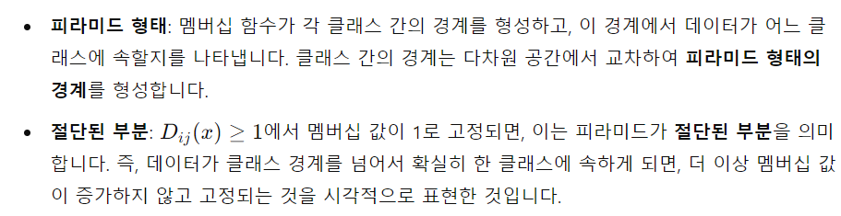
Introduction

Slide 5
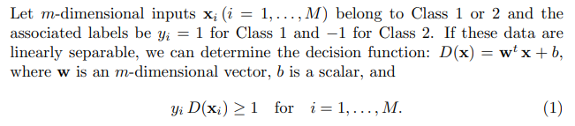

Two-class Support Vector Machines

Slide 6



Two-class Support Vector Machines

Slide 7
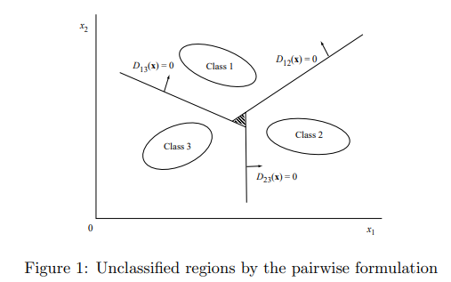

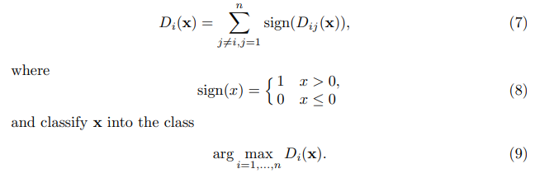
Fuzzy Support Vector Machines -Conventional Pairwise Classification

Slide 8


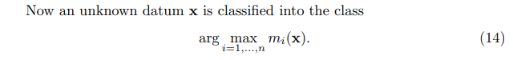
Fuzzy Support Vector Machines - Introduction of Membership Functions

Slide 9
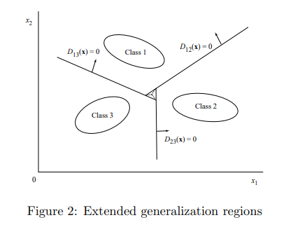
Fuzzy Support Vector Machines - Introduction of Membership Functions

Slide 10
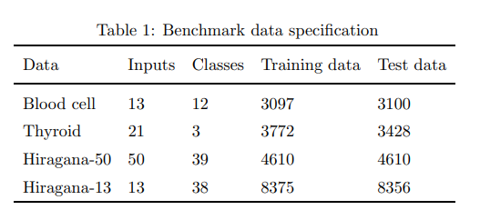
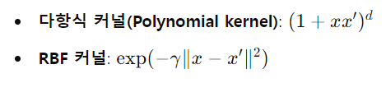
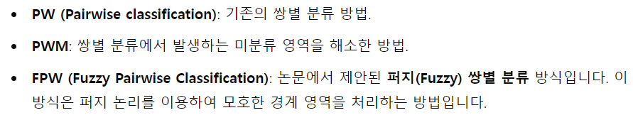
Performance Evaluation

Slide 11
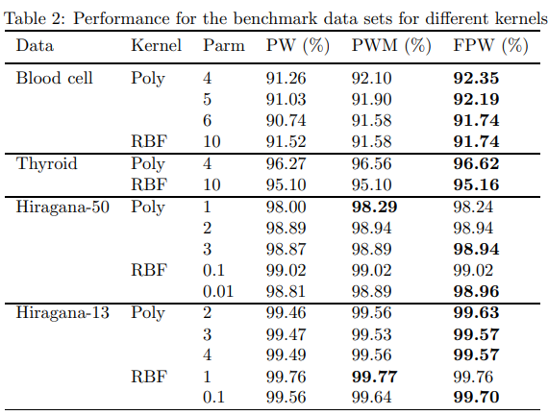
Performance Evaluation

Slide 12
Conclusions
conventional svm의 unclassifiable resions을 해결할 수 있는
pairwise classification을 위한 FuzzySVM에 대해 알아보았고,
pairwise classification를 이용한 SVM에서
FSVM의 일반화된 능률이 conventional SVM보다 우월하다는 것을 확인했습니다.

Slide 13
감사합니다

